Slide 1

Reinforcement Learning
Comparative Analysis of Q-learning and SARSA in the
Flappy Bird Game with Enhanced Reward Functions
Student : Phan Duy Kha, Nguyen Dinh Huy
Notes:
MSc 2 DATA SCIENCES & ARTIFICIAL INTELLIGENCE

Slide 2
Agenda
Introductions​
QLearning & SARSA
Evaluation
Discussion and Conclusion
Career goals
Math exercises and approaches
02
04
11
14
19
21
Notes:
My presentation includes:
Introduction,
Academic Journey,
Professional Experience,
Outstanding projects,
Career goals,
Math excersises and approaches.

Slide 3

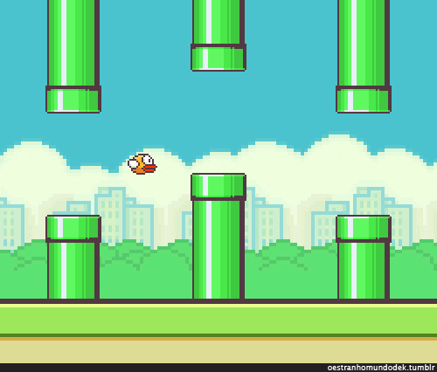
Introduction
Flappy Bird is a 2013 casual mobile game developed by Vietnamese video game artist and programmer Dong Nguyen
50 million times
5 million daily
$320 million
Flappy Bird is an arcade-style game in which the player controls the bird Faby, which moves persistently to the right. They are tasked with navigating Faby through pairs of pipes that have equally sized gaps placed at random heights. Faby automatically descends and only ascends when the player taps the touchscreen.
Notes:
My name is Huy and everyone can call me Tim,
I graduated in 2023 majoring in Construction Informatics, Faculty of Irrigation Engineering, Da Nang University of Science and Technology,
I have more than 2 years of working experience as FullStack – Data Engineer

Slide 4
Q-Learning and SARSA
Notes:
Academic Journey

Slide 5
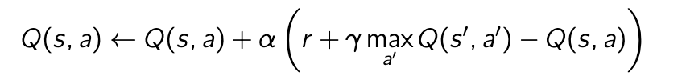
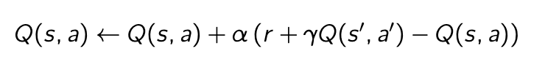
Q-learning
Principle: An off-policy method that updates the Q-value using the maximum estimated future reward from the next state:
Behavior: This approach is optimistic, leading to faster convergence but potentially riskier strategies.
SARSA
Principle: An on-policy method that updates the Q-value based on the action actually taken in the next state:
Behavior: By updating based on the actual action, SARSA tends to produce a more conservative policy that

Slide 6
Training and Testing
Notes:
Academic Journey

Slide 8
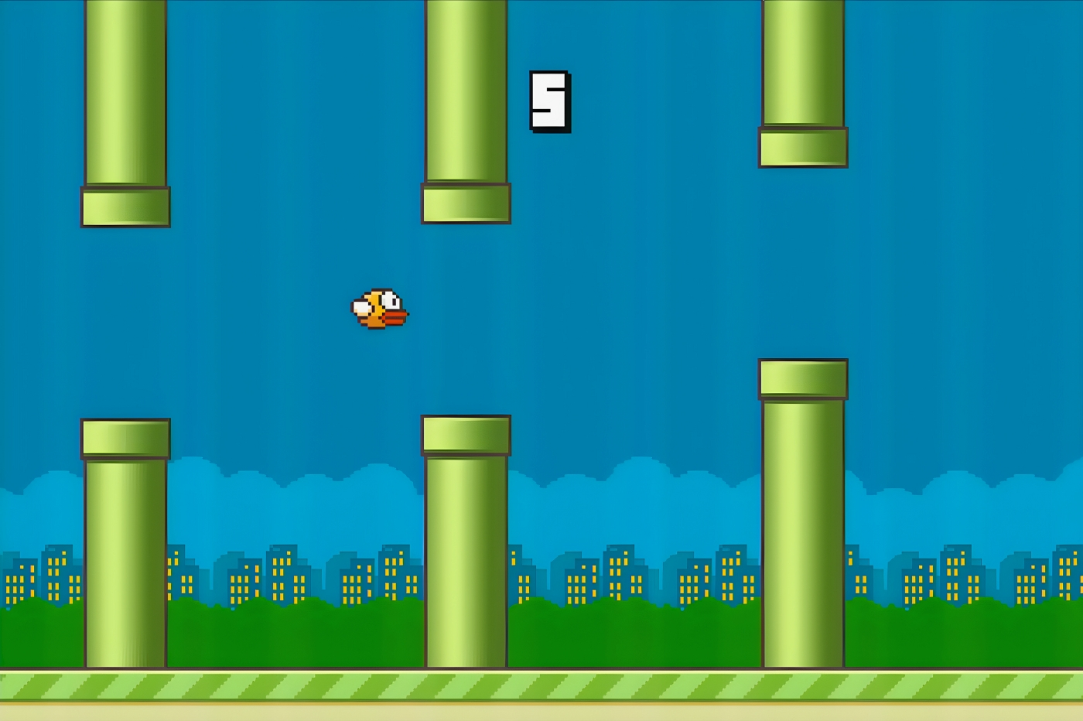

Flap (Move Up)
Vertical distance
Gap size
Mechanics
Do Nothing (Descent)
Velocity
Horizontal distance
Bonus Rewards

Slide 9
Missing a Gift
- 50
Passing a pipe
Score +1, reward +200
Collision or Out-of-Bounds:
-1000 reward
Collecting a Gift
+gift, reward + 500

Slide 10
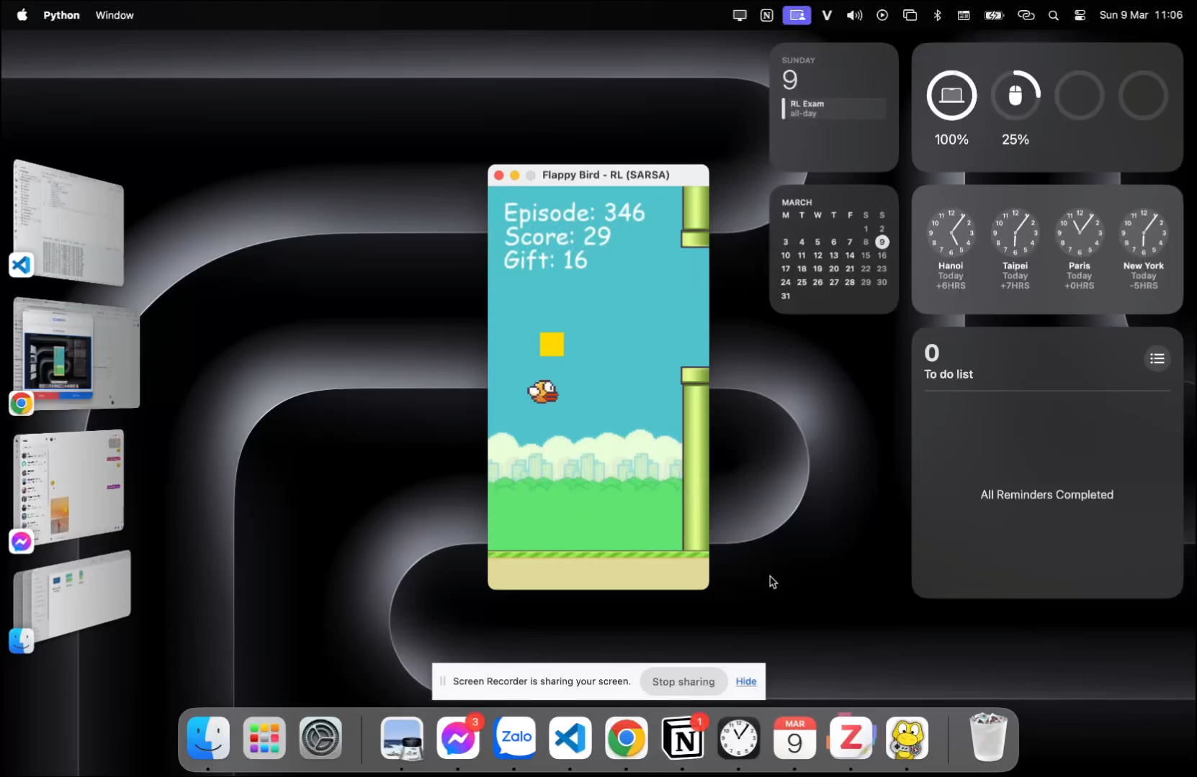
Training
The Flappy Bird game provides a consistent simulation environment. Key parameters include:
Learning rate (α): 0.1.
Discount factor (γ): 0.9.
Exploration rate (ϵ): Initially set high with gradual decay.
Number of episodes: 1000.

Slide 11
Testing
The Flappy Bird game provides a consistent simulation environment. Key parameters include:
Learning rate (α): 0.1.
Discount factor (γ): 0.9.
Exploration rate (ϵ): Initially set high with gradual decay.
Number of episodes: 1000.

Slide 12

Results
12

Slide 14
Thanks
14

